Slide 1
The Partition of the Sub-Continent in 1947
Course:
Bangladesh Studies

Slide 2
The creation of Pakistan and its Background
After World War II (1939-1945) British were pressured to reduce the size of their empire.
Lord Mountbatten agreed for the partition of British India.
Britain declared two states Pakistan & India.
Pakistan was separated by East and West, and they were separated by thousands of miles of Indian Territory.

Slide 3
Pakistan State
Pakistan had two states: West Pakistan & East Pakistan.
The East and West were very different in the way of their culture and the West area dominated the political ways of the country.
Urdu was spoken in the west and Bengali was spoken in the east
There are many causes and incidents which creates a separate state for Muslims.
British Divide and Rule Policy: It creates the communal sentiments among Hindus in this region.
Indian National Congress: Retired British civil service officer Allan Octavian Hume founded the Indian National Congress in 1885, A political party of India (British India to Free India)) in order to form a platform for civil and political dialogue.

Slide 4
3. Partition of Bengal in 1905: During Lord Curzon, in 1905 the British divided the huge province of Bengal or Bengal Presidency (formed in 1854) into a Western Part (Bengal) and Eastern Part (Eastern Bengal and Assam).
4. Formation of Muslim League in 1906: Indifferent attitude of the Congress towards Muslims, Congress’s anti Muslim stance, anti-partition agitation, Urdu-Hindu controversy- for these regions, Muslims have to organize themselves politically as separate community.
5. Sodeshi Andolon (Sodeshi Movement): For the causes of Partition of Bengal, the Hindu community extremely denied this decision.
6. Annulment of the Partition of Bengal in 1911: The British King George the fifth and Queen Merry visited India and Declared the Annulment of the Partition of Bengal in 1911.
7. Nehru Report in 1928 and Jinnah’s 14 Points in 1929: All party conference was held at Bombay in May 1928, this conference appointed a drafting committee under Motilal Nehru to draw up a Constitution for India.

Slide 5
8. The Two Nation Theory: In 1940, Jinnah addressed that Hindu and Muslims belong to two different religious philosophies, social costoms and Literature.
9. The Lahore Resolution in 1940: 27th annual session of All Indian Muslim League, the Resolution proposed by Fazlul Huq, the Prime Minister of Bengal. They demanded separate States for Muslims.
10. Separate State thinking of Muslim intellectuals: In 1930, the All Indian Muslim League Conference in Alahabad, Allama Iqbal demanded separate Land for Muslim Community and in 1932, Choudhury Rahmat Ali, the Student of Cambridge University gave an idea for creating state such as : Panjab-P, Afgahnistan-A, Kashmir-K, Sind-S and Beluchistan-TAN=PAKISTAN. On the other hand, in 1935, Alighar Muslim University demanded a separate state for Muslims.

Slide 6
11. Mountbatten Plan in 1947: He was the last Governor General in this region. The British Government was to send Him in order to arrange how and when, power was finally to be transferred into the hands of the Indian people. Making the future constitution under the Constituent assembly of election of 1946.
12. The Indian Independent Act in 1947:
According to Mountbatten plan, the Indian Independence Act, 1947 duly introduced in the British Parliament on 4 July received the Royal Assent on 18 July 1947. Salient Features are such as:
The Act provided for two dominion states: Pakistan and India.
The boundaries between the two dominion states were to be determined by a Boundary commission which was headed by Sir Cyril Radcliff.
Pakistan was to comprise the West Punjab, East Bengal, Sind, North West frontier provinces, Sylhet divisions of Assam Baluchistan. India with rest of teritories.

Slide 7
After 15 August 1947, the control of the British Parliament did not execute to this Dominion States. Thus the end of about 200 year’s British rule in this region completed.
Muslim league welcomed the Act and the constituent assembly of Pakistan met on August 11, 1947 and elected Mohammad Ali Jinnah, the president and was revered as the Quaid-i-Azam. After three days he was sworn in as Governor General and Liaquat Ali Khan became the priminister of Pakistan.
On the other hand, the Constituent Assembly appointed Lord Maounbatten as the first Govenor General of the Indian Dominion. In the morning of august 15, 1947, a new cabinet headed by Jawahar Lal Nehru who was sworn in as the prime Minister of India.
So, after passing the different historical and communal events, Pakistan in 14 August and India in 15 August were existed as a Sovereign States in world Map.

Slide 8
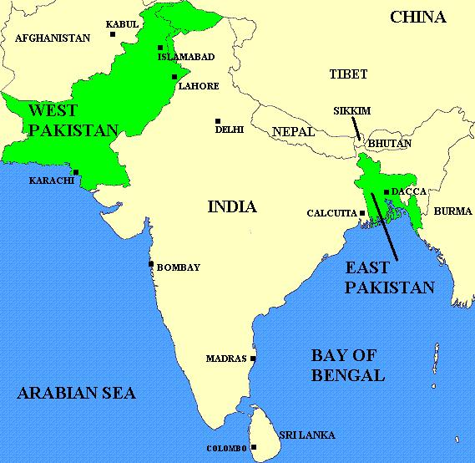

Slide 9
THANKS

